Slide 1

Lecture # 2
Digital Image Processing
Sampling & Quantization
1st Semester
2019-2020
Dr. Abdulhussein Mohsin Abdullah
Computer Science Dept., CS & IT College, Basrah Univ.

Slide 2
Elements of visual perception
Goal: help an observer interpret the content of an image
Developing a basic understanding of the visual process is important
Brief coverage of human visual perception follows
– Emphasis on concepts that relate to subsequent material

Slide 3
Image Formation

Slide 4
image formation
The amount of light reflected by an object in the physical world (3d world) is pass through the lens of the camera and it becomes a 2d signal.

Slide 5
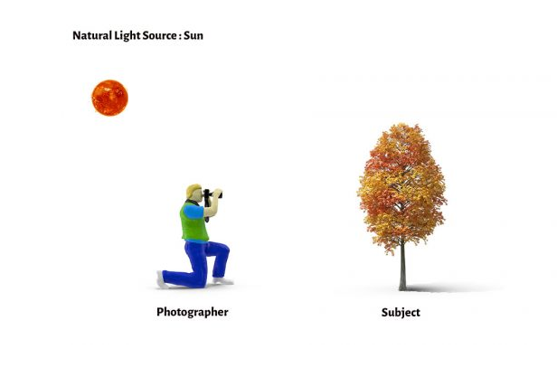
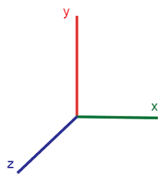


For natural images we need a light source (λ: wavelength of the source) .
– E(x,y, z, λ): incident light on a point (x,y,z world coordinates of the point)
Each point in the scene has a reﬂectivity function.
– r(x, y,z,λ): reﬂectivity function
Light reﬂects from a point and the reﬂected light is captured by an imaging device.
– c(x, y,z, λ) = E(x,y, z, λ) × r(x, y, z, λ): reﬂected light.
E(x,y, z, λ)
c(x, y,z, λ) = E(x,y, z, λ) × r(x, y,z,λ)
Camera (c(x, y, z, λ)) =

Slide 6
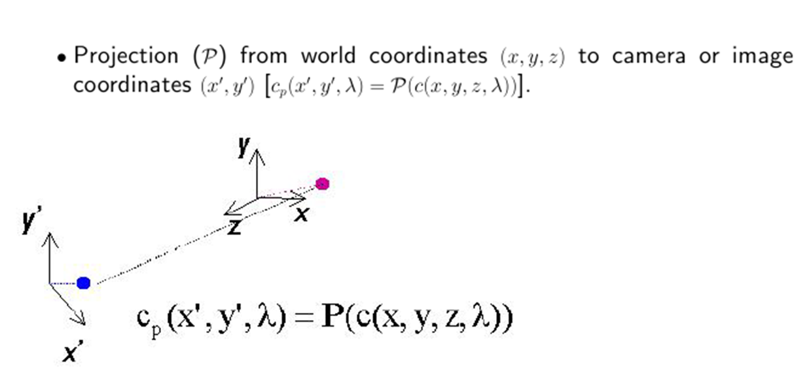
Inside the Camera - Projection
Camera (c(x, y, z, λ)) =

Slide 7
• There are two types of projections (P) of interest to us:
1. Perspective Projection
– Objects closer to the capture device appear bigger . Most image formation situations can be considered to be under this category, including images taken by camera and the human eye.
2. Orthographic Projection
– This is “unnatural”. Objects appear the same size
regardless of their distance to the “capture device”.
• Both types of projections can be represented via mathematical formulas. Orthographic projection is easier and is sometimes used as a mathematical convenience.

Slide 8
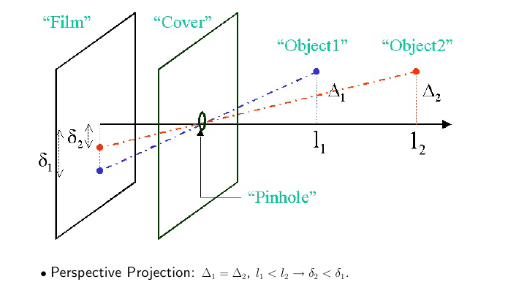

Slide 9
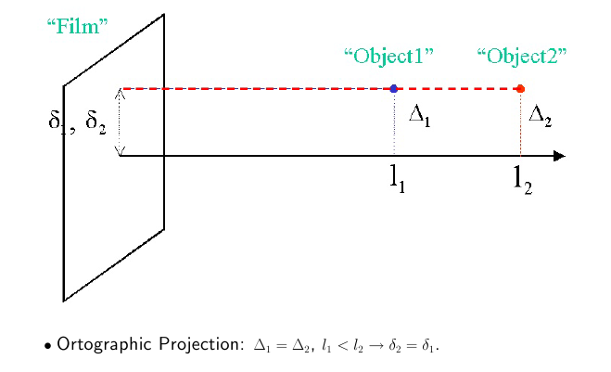

Slide 10


The function f (x, y, λ) includes the effect of wavelength or frequency of the measured radiation.
Visible light has wavelengths, λ, from about 400 nm (blue) to 700 nm (red).
This will produce a single-band image,
where si(λ) is the sensitivity of the ith sensor, which defines the ith band. We often denote the N-band image by the vector
It is often the case that each of the bands is treated as a monochrome image.

Slide 11
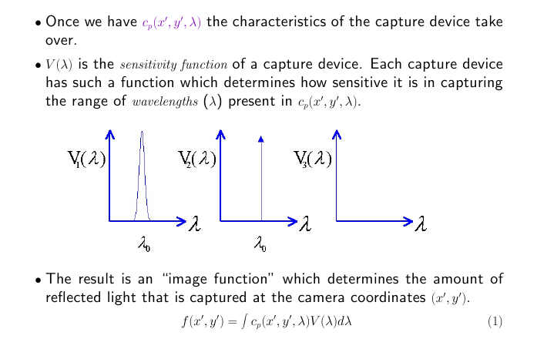
Inside the Camera - Sensitivity

Slide 12
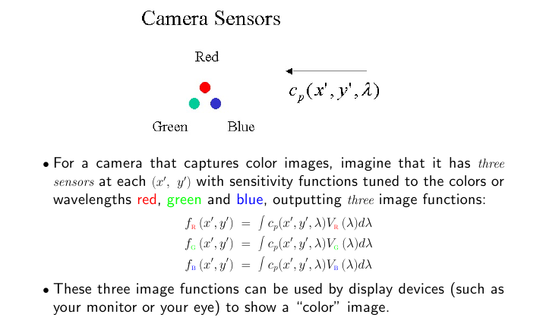
Sensitivity and Color

Slide 13
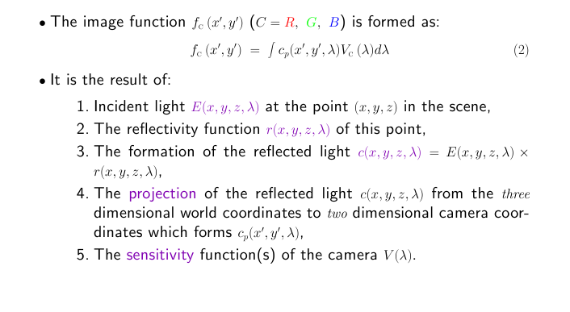
Summary

Slide 14
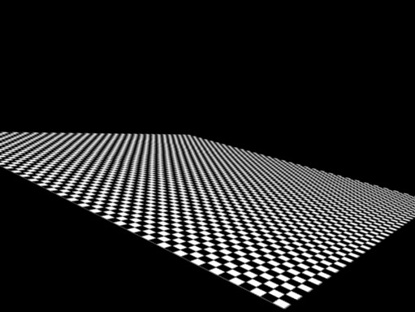
First Look at Sampling, Aliasing,
Sampling and Aliasing

Slide 15

What happens when you look at a textured object in a steep angle?
image plane
camera/eye
checkerboard texture

Slide 16
Aliasing
What happens when you look at a textured object in a steep angle?
  Even though every ray corresponds to a distance of one pixel in the image, the world-space intervals get larger
  At some point, we start missing the squares altogether
– If we just take one point sample
at the hit location, we get pretty much random results!
CS-C3100 Fall 2018 – Lehtinen

Slide 17
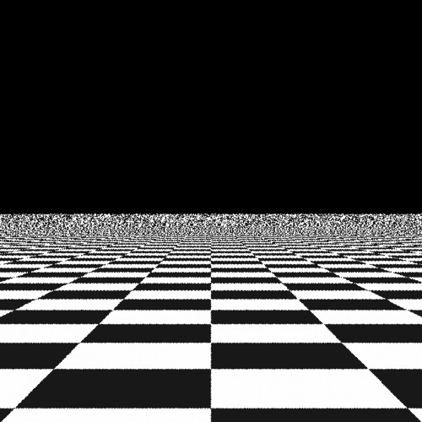
Aliasing – What Does it Look Like?
Image: Xiaohu Zhang

Slide 18
Most things in the real world are continuous, yet everything in a computer is discrete
The process of mapping a continuous function to a discrete one is called sampling
The process of mapping a continuous variable to a discrete one is called quantization
To represent or render an image using a computer, we must both sample and quantize

Slide 19
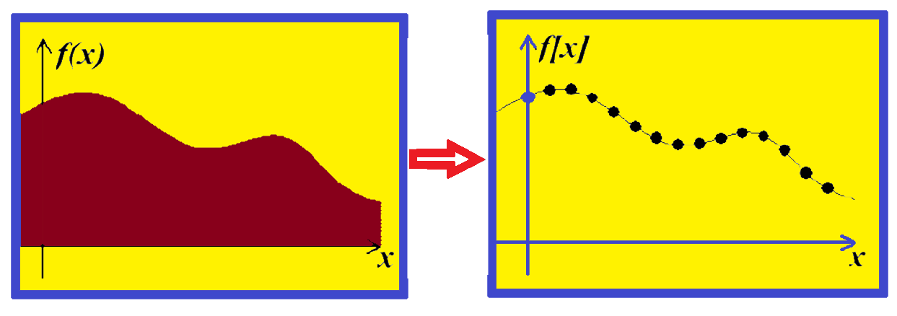
continuous value
discrete value

Slide 20
Down-sampling

Slide 21
Aliasing can arise when you sample a continuous signal or image
  – occurs when your sampling rate is not high enough to capture the amount of detail in your image
  – Can give you the wrong signal/image—an alias
  – the sampling rate must be high enough to capture the highest frequency in the image
To avoid aliasing:
  – sampling rate ≥ 2 * max frequency in the image
    • said another way: ≥ two samples per cycle
  – This minimum sampling rate is called the Nyquist rate

Slide 22
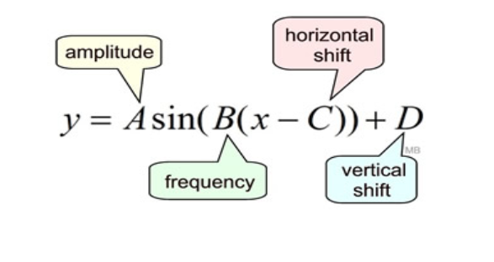
The Amplitude is the height from the center line to the peak
The Phase Shift is how far the function is shifted horizontally / vertically from the usual position.
The Period goes from one peak to the next (or from any point to the next matching point):
The frequency of a trigonometric function is the number of cycles it completes in a given interval.

Slide 23
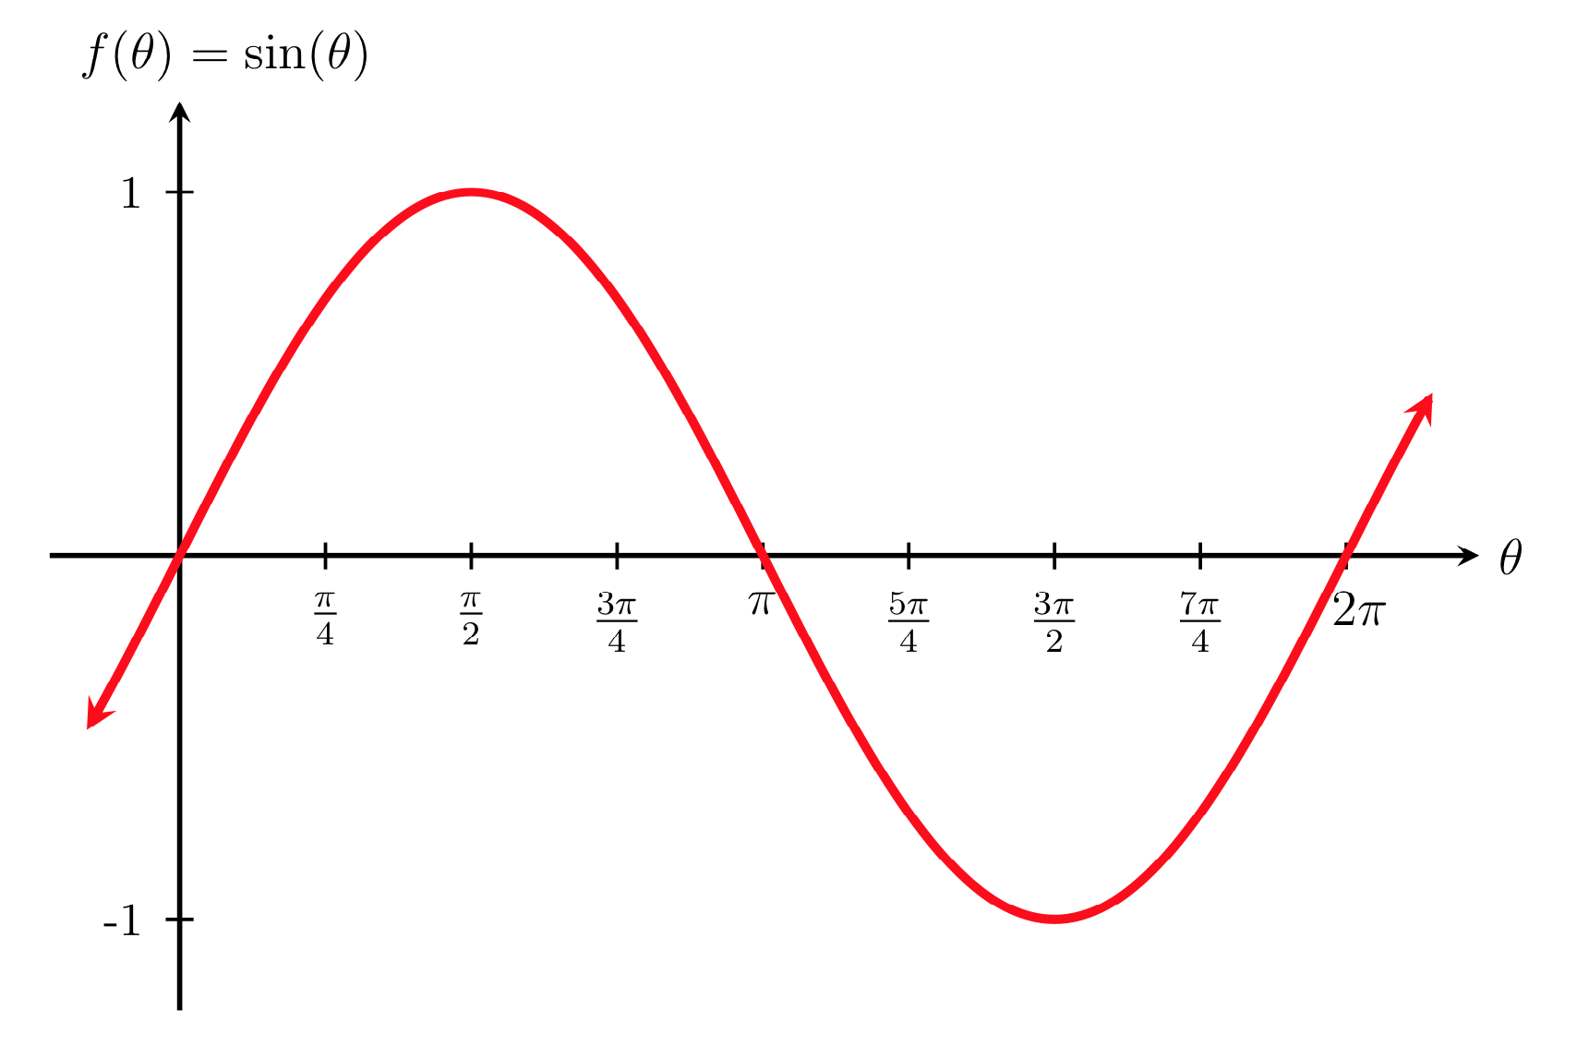


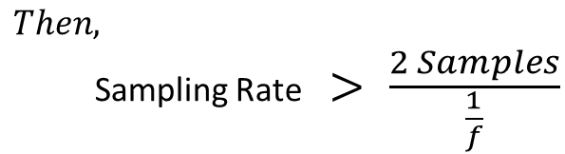

F(t)= A sin(ft) + Q
3 unknowns, to solve in equation we need 3 points.
That is mean we need
Amplitude
Frequency
Phase
1 cycle in period time T
$$Sampling Rate≥\frac{2 Samples}{T}$$
$$Since T=\frac{1}{f}$$
$$Then,$$
Sampling Rate $> \frac{2 Samples}{\frac{1}{f}}$
$$Sampling Rate>2f Samples$$
Nyquist Rate = 2f

Slide 24
2D example

Slide 25
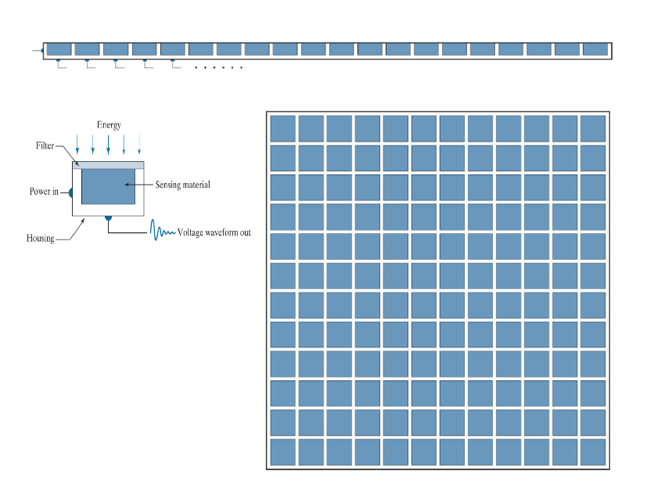
Types of Image Sensors
Single Sensor
Line Sensor
Array Sensor

Slide 26
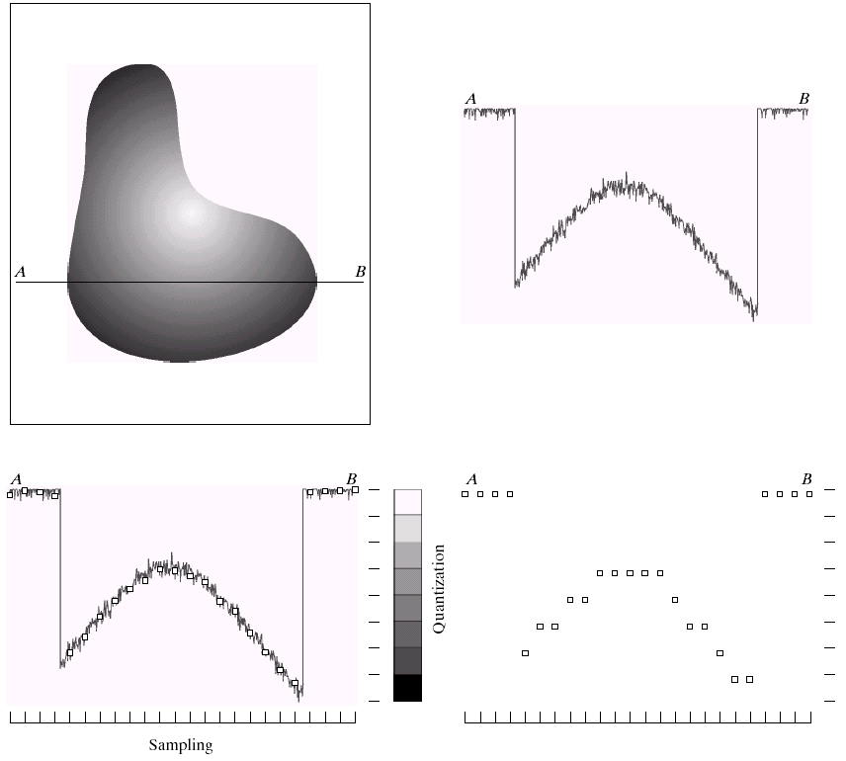
y (intensity values)
a | b
c | d
Generating a digital image. (a) Continuous image. (b) A scaling line from A to B in the continuous image, used to illustrate the concepts of sampling and quantization. (c) sampling and quantization. (d) Digital scan line.

Slide 27
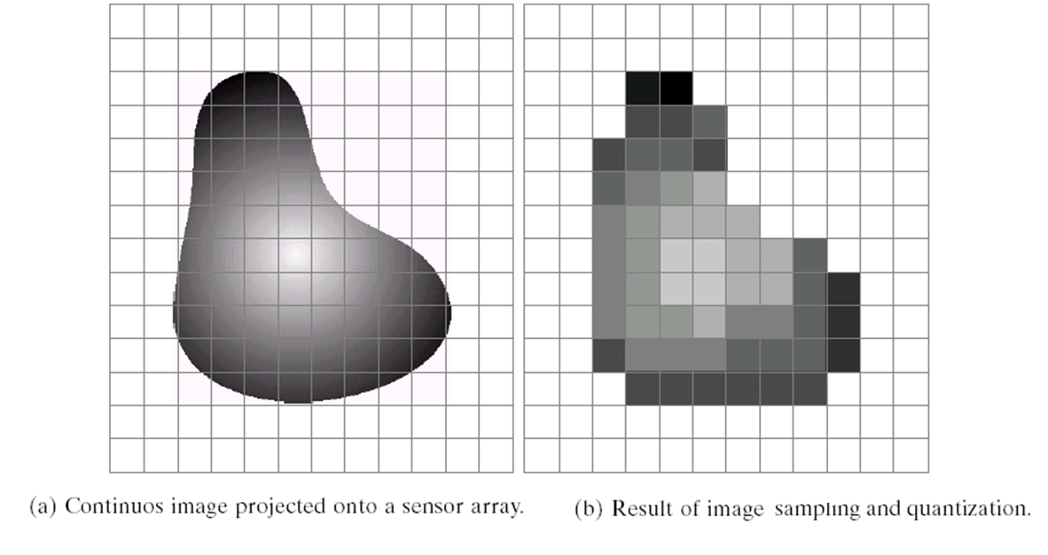

Slide 28

0 | 0 | 0 | 75 | 75 | 75 | 128 | 128 | 128 | 128
0 | 75 | 75 | 75 | 128 | 128 | 128 | 255 | 255 | 255
75 | 75 | 75 | 200 | 200 | 200 | 255 | 255 | 255 | 200
128 | 128 | 128 | 200 | 200 | 255 | 255 | 200 | 200 | 200
128 | 128 | 128 | 255 | 255 | 200 | 200 | 200 | 75 | 75
175 | 175 | 175 | 225 | 225 | 225 | 75 | 75 | 75 | 100
175 | 175 | 100 | 100 | 100 | 225 | 225 | 75 | 75 | 100
75 | 75 | 75 | 35 | 35 | 35 | 0 | 0 | 0 | 35
35 | 35 | 35 | 0 | 0 | 0 | 35 | 35 | 35 | 75
75 | 75 | 75 | 100 | 100 | 100 | 200 | 200 | 200 | 200

Slide 29
=

Slide 30
Sampling

Slide 31
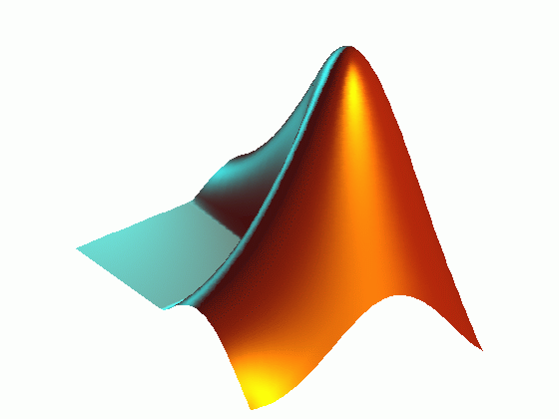
imread() – reading an image with different postfixes
imresize() – resizing an image to any given size
figure – opening a new graphical window
subplot(#of row, # of col, location) – showing different plots/images in one graphical window
imshow() – displaying an image
Matlab

Slide 32


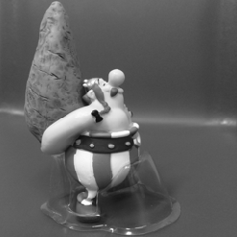
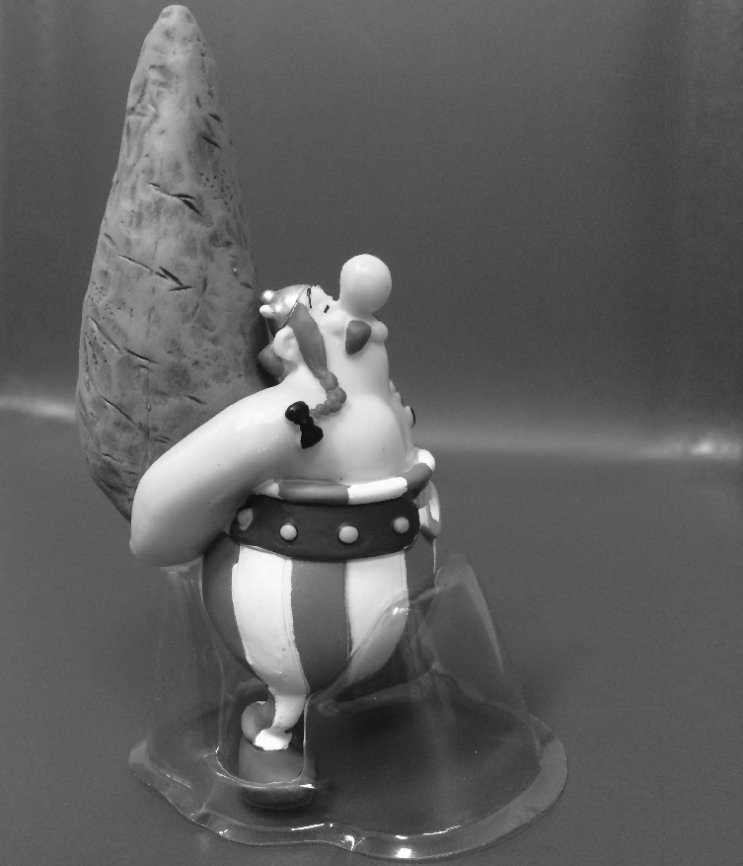

im=imread('obelix.jpg');
im=rgb2gray(imread('obelix.jpg'));
im1=imresize(im, [1024 1024]);
im2=imresize(im1, [1024 1024]/2);
im3=imresize(im1, [1024 1024]/4);
im4=imresize(im1, [1024 1024]/8);
im5=imresize(im1, [1024 1024]/16);
im6=imresize(im1, [1024 1024]/32);
figure;imshow(im1)
figure;imshow(im2)
figure;imshow(im3)
figure;imshow(im4)
figure;imshow(im5)
32
64
128
256
512
1024

Slide 33
Quantization
8-bit
7-bit
6-bit
5-bit
4-bit
3-bit
2-bit
1-bit

Slide 34
generating figure of previous slide
im=imread('obelix.jpg');
im=rgb2gray(imread('obelix.jpg'));
im1=imresize(im, [1024 1024]);
im2= gray2ind(im1,2^7);
im3= gray2ind(im1,2^6);
im4= gray2ind(im1,2^5);
im5= gray2ind(im1,2^4);
im6= gray2ind(im1,2^3);
im7= gray2ind(im1,2^2);
im8= gray2ind(im1,2^1);

Slide 35
figure;
subplot(2,4,1);imshow(im1,[]);subplot(2,4,2);imshow(im2,[])
subplot(2,4,3);imshow(im3,[]);subplot(2,4,4);imshow(im4,[])
subplot(2,4,5);imshow(im5,[]);subplot(2,4,6);imshow(im6,[])
subplot(2,4,7);imshow(im7,[]);subplot(2,4,8);imshow(im8,[])

Slide 36
Spatial and Intensity Resolution
Sampling is the principal factor defining the spatial resolution of an image, and quantization is the principal factor defining the intensity resolution.
Spatial resolution - number of rows and columns for example: 128 x128, 256 by 256, etc.; -->see Figs. 2.19 and 2.20
Intensity resolution - number of gray levels for example: 8 bits, 16 bits, etc.;

Slide 37
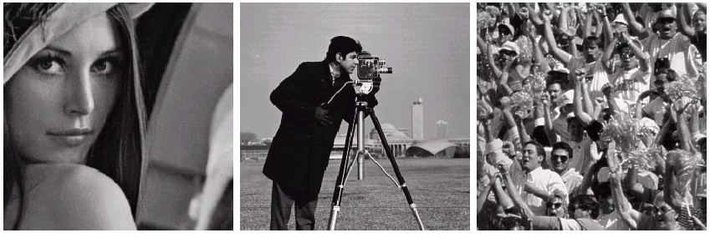
How to select the suitable size and pixel depth of images
The word “suitable” is subjective: depending on “subject”.
Low detail image
Medium detail image
High detail image
Lena image
Cameraman image
To satisfy human mind
1. For images of the same size, the low detail image may need
more pixel depth.
2. As an image size increase, fewer gray levels may be needed.
(Images from Rafael C. Gonzalez and Richard E.
Wood, Digital Image Processing, 2nd Edition.

Slide 38
Neighbors of a Pixel
Any pixel p(x, y) has two vertical and two horizontal neighbors, given by
(x+1, y), (x-1, y), (x, y+1), (x, y-1)
This set of pixels are called the 4-neighbors of P, and is denoted by N₄(P).
Each of them are at a unit distance from P.

Slide 39
Neighbors of a Pixel
The four diagonal neighbors of p(x,y) are given by,
(x+1, y+1), (x+1, y-1), (x-1, y+1), (x-1 ,y-1)
This set is denoted by N_{D}(P).
Each of them are at Euclidean distance of
1.414 from P.

Slide 40
Neighbors of a Pixel
The points N_{D}(P) and N₄(P) are together known as 8-neighbors of the point P, denoted by N₈(P).
Some of the points in the N₄, N_{D} and N₈ may fall outside image when P lies on the border of image.

Slide 41


Neighbors of a Pixel
Neighbors of a pixel
4-neighbors of a pixel p are its vertical and horizontal neighbors denoted by N₄(p)
8-neighbors of a pixel p are its vertical horizontal and 4 diagonal neighbors denoted by N₈(p)
p
N₄(p)
p
N₈(p)

Slide 42
Neighbors of a Pixel
N_{D} N₄ N_{D}
N₄ P N₄
N_{D} N₄ N_{D}
•N₄ - 4-neighbors
•N_{D} - diagonal neighbors
•N₈ - 8-neighbors (N₄ U N_{D})

Slide 43
Basic Relationship of Pixels
(0,0)
x
(x-1,y-1)
(x,y-1)
(x+1,y-1)
(x-1,y)
(x,y)
(x+1,y)
y
(x-1,y+1)
(x,y+1)
(x+1,y+1)
Conventional indexing method

Slide 44
Neighbors of a Pixel
Neighborhood relation is used to tell adjacent pixels. It is useful for analyzing regions.
4-neighbors of p:
(x,y-1)
(x−1,y)
(x+1,y)
(x,y−1)
(x,y+1)
(x-1,y)
p
(x+1,y)
N₄(p) =
(x,y+1)
4-neighborhood relation considers only vertical and
horizontal neighbors.
Note: q ∈ N₄(p) implies p ∈ N₄(q)

Slide 45
Neighbors of a Pixel
8-neighbors of p:
(x-1,y-1)
(x,y-1)
(x+1,y-1)
(x−1,y−1)
(x,y−1)
(x+1,y−1)
(x−1,y)
(x+1,y)
(x−1,y+1)
(x,y+1)
(x+1,y+1)
(x-1,y)
p
(x+1,y)
(x-1,y+1)
(x,y+1)
(x+1,y+1)
N₈(p) =
8-neighborhood relation considers all neighbor pixels.

Slide 46
Neighbors of a Pixel
Diagonal neighbors of p:
(x-1,y-1)
(x+1,y-1)
(x−1,y−1)
(x+1,y−1)
(x−1,y+1)
(x+1,y+1)
p
N_{D}(p) =
(x-1,y+1)
(x+1,y+1)
Diagonal -neighborhood relation considers only diagonal neighbor pixels.

Slide 47
Adjacency
Two pixels are connected if they are neighbors and their gray levels satisfy some specified criterion of similarity.
For example, in a binary image two pixels are connected if they are 4-neighbors and have same value (0/1).

Slide 48
Connectivity
Connectivity is adapted from neighborhood relation.
Two pixels are connected if they are in the same class (i.e. the same color or the same range of intensity) and they are neighbors of one another.
Let V be set of gray levels values used to define adjacency.
For p and q from the same class
w 4-connectivity: p and q are 4-connected if q ∈ N₄(p)
w 8-connectivity: p and q are 8-connected if q ∈ N₈(p)
w mixed-connectivity (m-connectivity):
p and q are m-connected if
1. q ∈ N₄(p)
or
2. q ∈ N_{D}(p) and N₄(p) ∩ N₄(q) = ∅

Slide 50
Connectivity :
To determine whether the pixels are adjacent in some sense.
V = {1, 2}
0
0
0
1
2
0
1
0
1
Let V be the set of gray-level values used to define connectivity of the pixels p, q that have values from the set V are:
a.
0
0
0
1
2
0
1
0
1
b.
4-connected, if q is in the set N₄(p)
8-connected, if q is in the set N₈(p)
m-connected, iff
q is in N₄(p) or
q is in N_{D}(p) and the set
0
0
0
1
2
0
1
0
1
c.
N ₄ ( p) I N ₄ (q)
is empty

Slide 51
Adjacency/Connectivity
0 1 1
0 1 0
0 0 1
8-adjacent m-adjacent

Slide 52
Adjacency
A pixel p is adjacent to pixel q is they are connected.
Two image subsets S₁ and S₂ are adjacent if some pixel in S₁ is adjacent to some pixel in S₂
S₁
S₂
We can define type of adjacency: 4-adjacency, 8-adjacency or m-adjacency depending on type of connectivity.

Slide 53
Path
A path from pixel p at (x,y) to pixel q at (s,t) is a sequence
of distinct pixels:
(x₀,y₀), (x₁,y₁), (x₂,y₂),…, (x_{n},y_{n})
such that
(x₀,y₀) = (x,y) and (x_{n},y_{n}) = (s,t)
and
(x_{i},y_{i}) is adjacent to (x_{i-1},y_{i-1}), i = 1,…,n
Here n is the length of the path.
q
p
We can define type of path: 4-path, 8-path or m-path depending on type of adjacency.

Slide 54
Path
8-path
m-path
p
p
p
q
q
q
m-path from p to q
solves this ambiguity
8-path from p to q
results in some ambiguity

Slide 55
Regions and Boundaries
A subset R of pixels in an image is called a Region of the image if R is a connected set.
The boundary of the region R is the set of pixels in the region that have one or more neighbors that are not in R.
If R happens to be entire Image?

Slide 56
Distance
For pixel p, q, and z with coordinates (x,y), (s,t) and (u,v), D is a distance function or metric if
w D(p,q) ≥ 0 (D(p,q) = 0 if and only if p = q)
w D(p,q) = D(q,p)
w D(p,z) ≤ D(p,q) + D(q,z)
Example: Euclidean distance

Slide 57
Distance
D₄-distance (city-block distance) is defined as
2
2
1
2
2
1
0
1
2
2
1
2
2
Pixels with D₄(p) = 1 is 4-neighbors of p.

Slide 58
Distance
D₈-distance (chessboard distance) is defined as
2
2
2
2
2
2
1
1
1
2
2
1
0
1
2
2
1
1
1
2
2
2
2
2
2
Pixels with D₈(p) = 1 is 8-neighbors of p.

Slide 59
V ={0, 1}
V ={1, 2}
Find path 4-, 8-, m-
q
3
1
2
1
0
2
0
2
1
2
1
1
1
0
1
2
P

